Slide 1


CV & ML: Basics of Linear Algebra Lecture 2 by Anna Levant, PhD

Slide 2
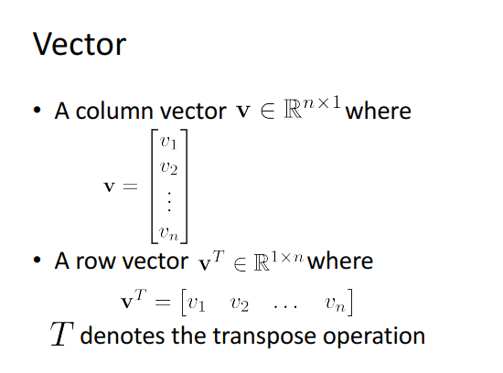
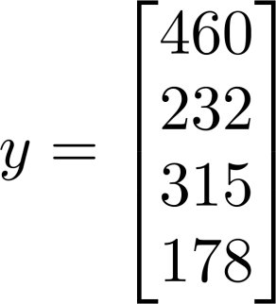
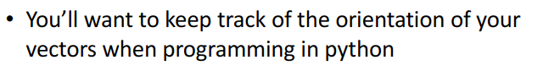
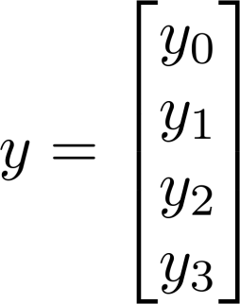
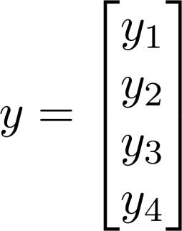
Example: 4-dimensional column vector
i- index - location in the vector
1-indexed (Math) 0-indexed (Python):

Slide 3
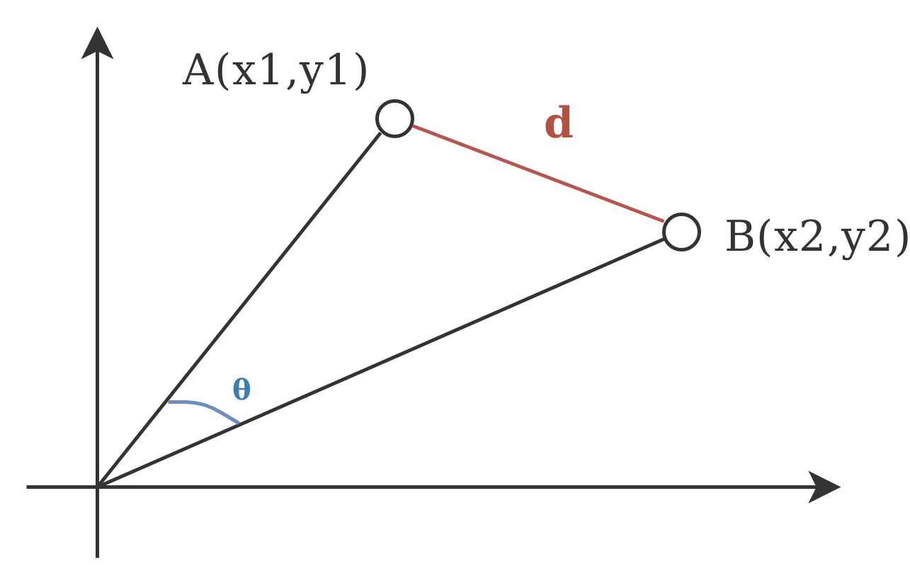
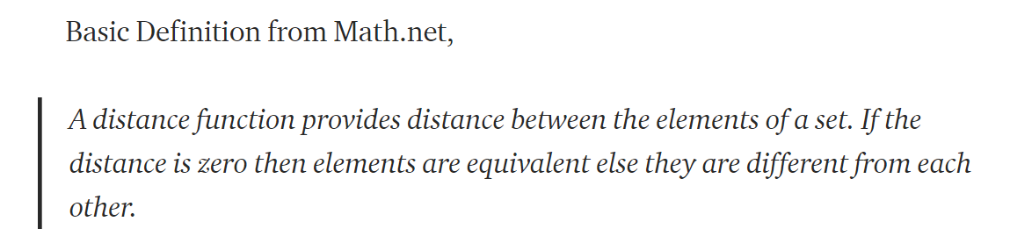
Vector Distance
Euclidean distance - is like using a ruler measure the distance
Cosine similarity measures angle between vectors
( not taking into regard their magnitude)
There are 7 different distances used in machine learning! But we will focus on these 2
Notes:
A distance function is nothing but a mathematical formula used by distance metrics. The distance function can differ across different distance metrics. Let’s talk about different distance metrics and understand their role in machine learning modelling.

Slide 4
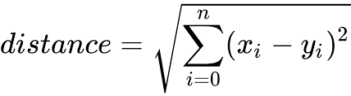
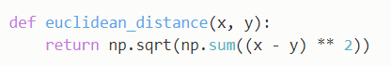
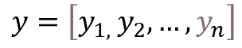
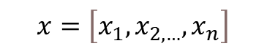
Euclidian Distance
(מרחק אוקלידי)
By “The Pythagorean Theorem”
(משפט פיתגורס)
$$d=\sqrt{{\left(x_{2}−x_{1}\right)}^{2}+{\left(y_{2}−y_{1}\right)}^{2}}$$
y1
y2-y1
y2
x2-x1
Also true for n-dimensional if
$$x=\left[x_{1},x_{2,…},x_{n}\right]$$
$$y=\left[y_{1, }y_{2},…,y_{n}\right]$$
x1
x2
Python:

Slide 5
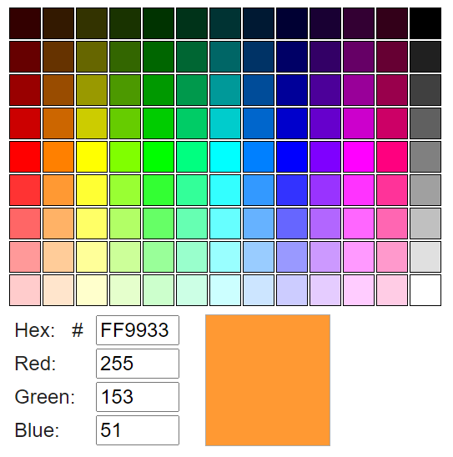
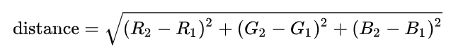
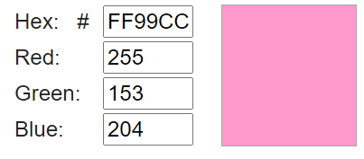
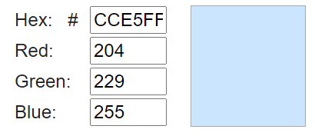
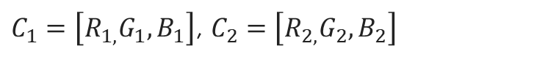
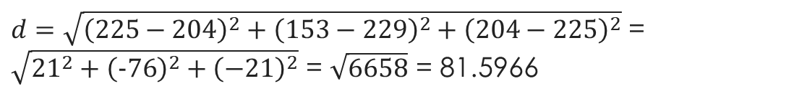
Example of using Euclidian distance: colors comparison
RGB color space constructs all the colors from the combination of the Red, Green and Blue colors.
To compare how 2 colors are similar we calculate distance between them :
$C_{1}=\left[R_{1,}G_{1},B_{1}\right]$, $C_{2}=\left[R_{2,}G_{2},B_{2}\right]$
Let’s find the distance between the following 2 colors:
$d=\sqrt{{\left(225−204\right)}^{2}+{\left(153−229\right)}^{2}+{\left(204−225\right)}^{2}}$ = $\sqrt{{21}^{2}+{\left(−76\right)}^{2}+{\left(−21\right)}^{2}}$ = $\sqrt{6658}$ = 81.5966

Slide 6
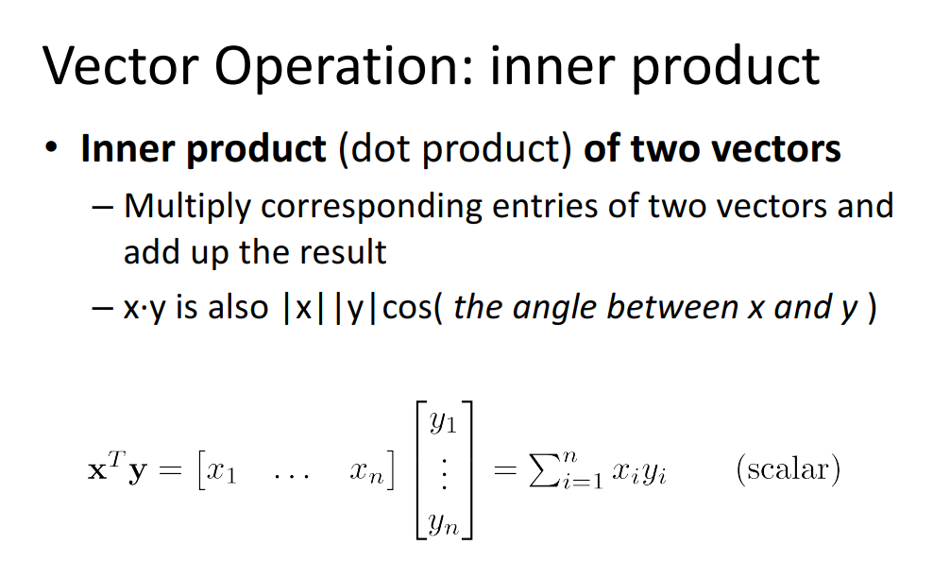
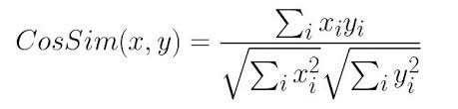
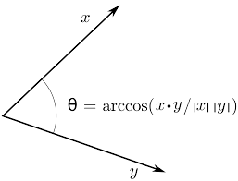
Cosine similarity
CosSim = 1 (ϴ = 0 degrees) – vectors are similar
CosSim = 0 (ϴ = 90 degrees) – vectors are not similar
Python:

Slide 7

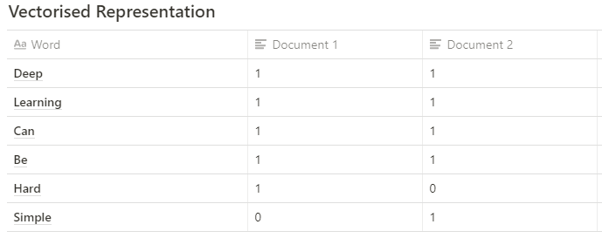
Example of using cosine similarity: document similarity
Here’s an example:
Document 1: Deep Learning can be hard
Document 2: Deep Learning can be simple
Step 1: First we obtain a vectorised representation of the texts
Photo by Annie Spratt on Unsplash
Step 2: Find the cosine similarity
1) Calculate the dot product A∙ B:
A∙ B = 4
2) Calculate the magnitude of A:
|A|= 2.2360679775
3) Calculate the magnitude of B:
|B|= 2.2360679775
4) Calculate the cosine similarity:
Cos ϴ = (4) / (2.2360679775*2.2360679775) = 0.80 (80% similarity between the sentences in both document)
Document 1: [1, 1, 1, 1, 1, 0] let’s refer to this as A
Document 2: [1, 1, 1, 1, 0, 1] let’s refer to this as B
Above we have two vectors (A and B) that are in a 6-dimensional vector space

Slide 8

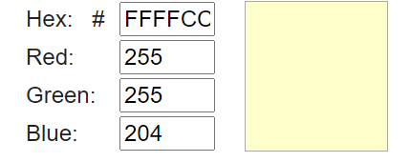

Quiz 1: What is the value of vector at location i=3
Math vector representation
Python representation
Quiz 2: Which 2 colors of the following are more similar and what is the Euclidian distance between them:
Vector quiz
Quiz 3: a) Calculate cosine similarity between 2 documents bellow:
Document 1 : We are learning machine learning course
Document 2 : We are learning computer vision course
b) What is the dimension of vectors you are working with?
Quiz 4: Compute Euclidian distance and Cosine similarity between following 2 vectors:
A = [1,3,5], B= [-3,6,2]

Slide 9
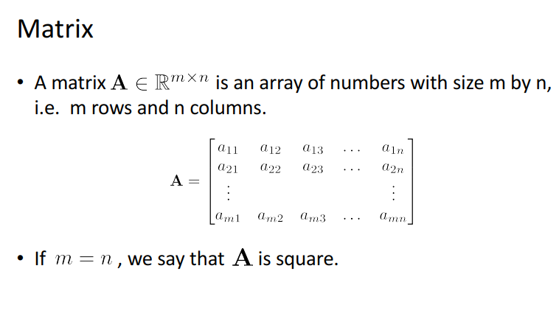
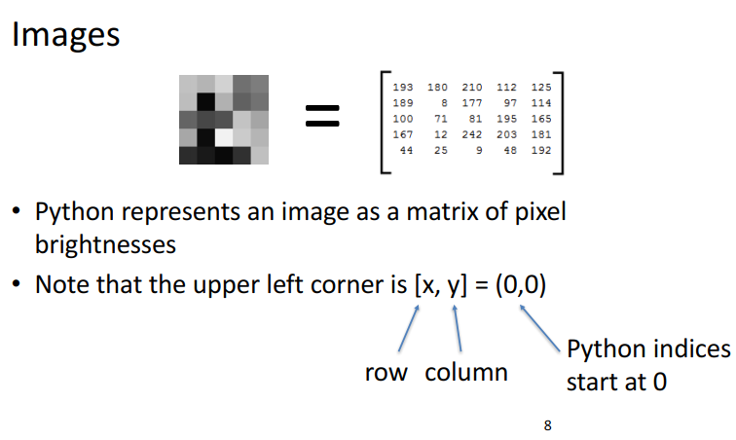
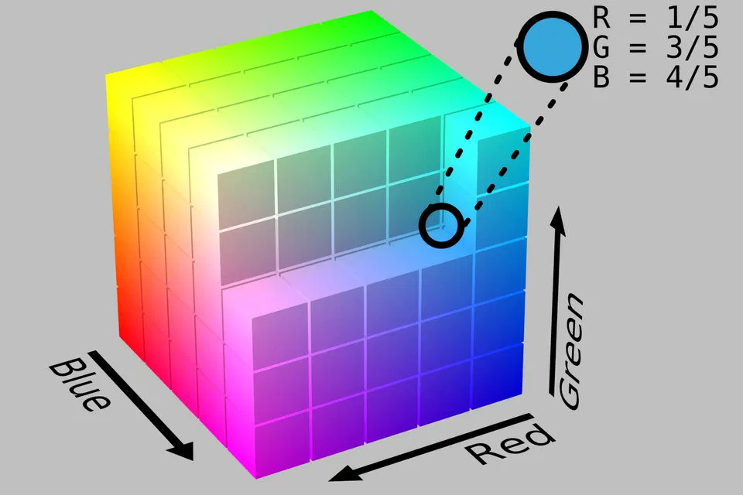
a_{ij} = “ i , i entry” in the i row, j column
I =
[i,j]

Slide 10
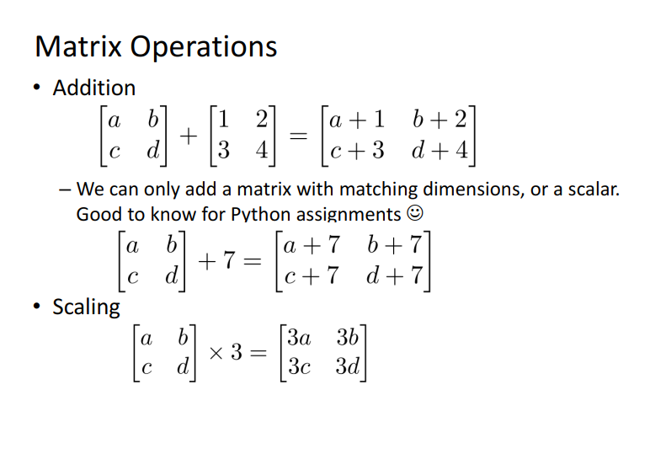
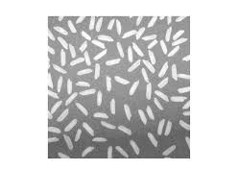

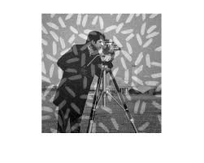
+
=

Slide 11
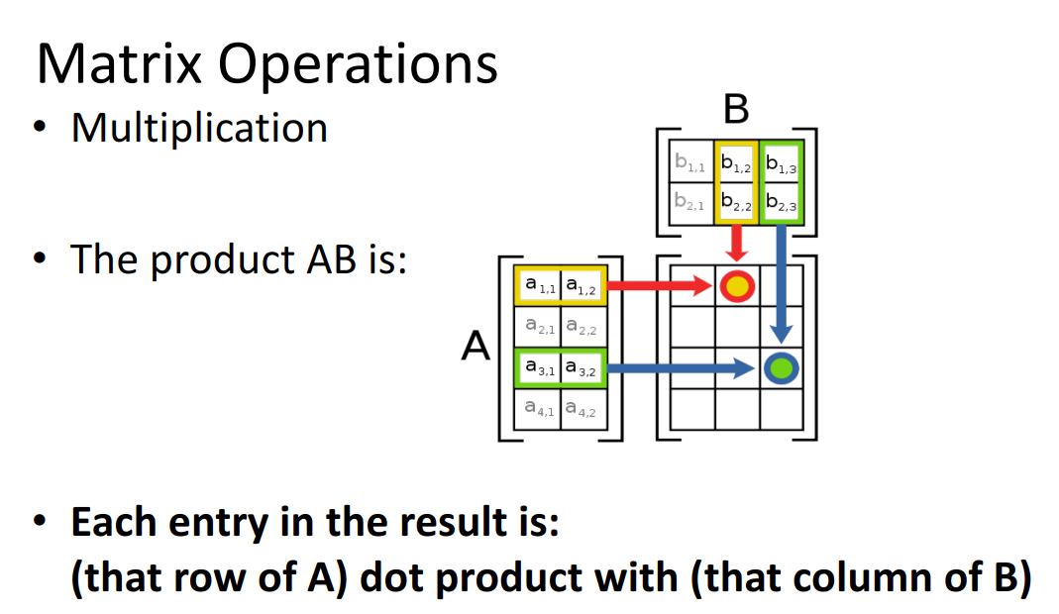
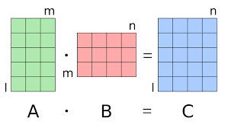
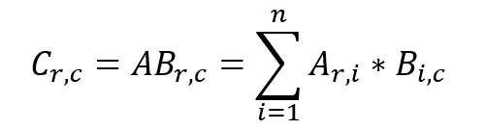
[lxm]
[mxn]
[lxn]

Slide 12
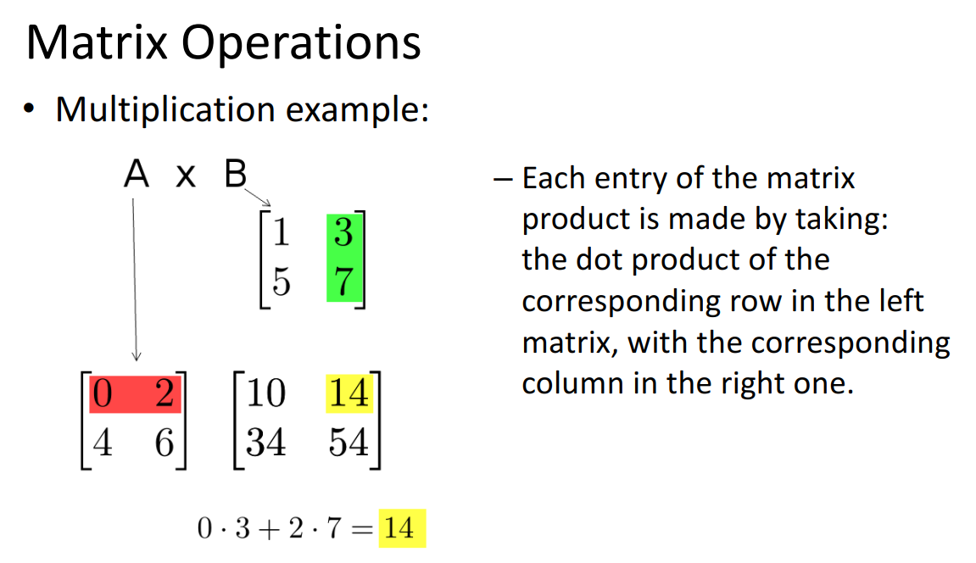

Slide 13
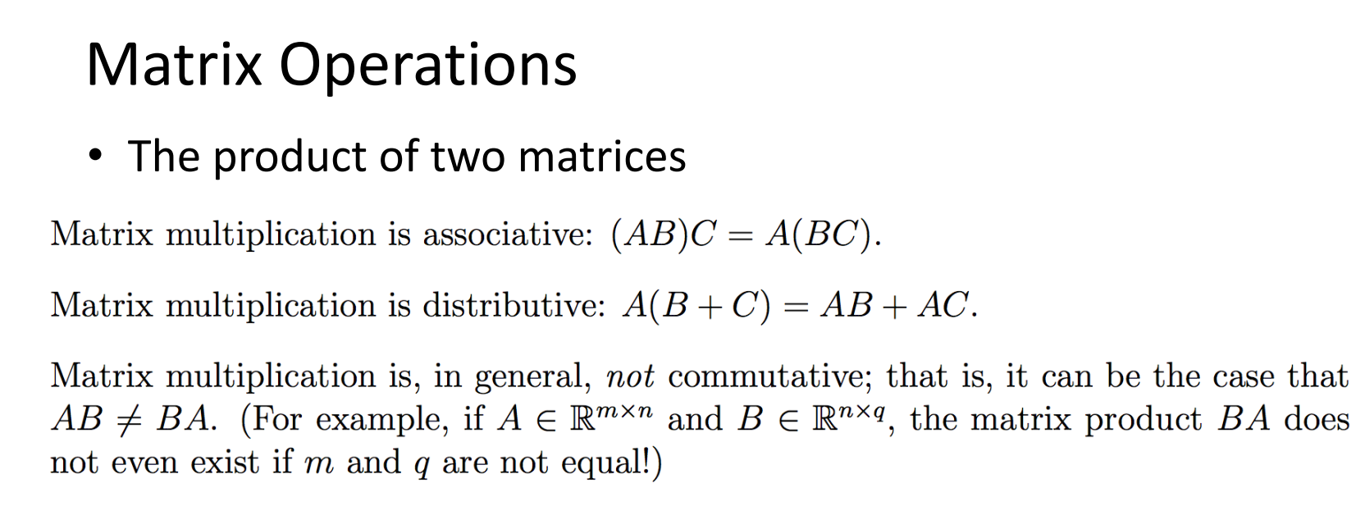

Slide 14
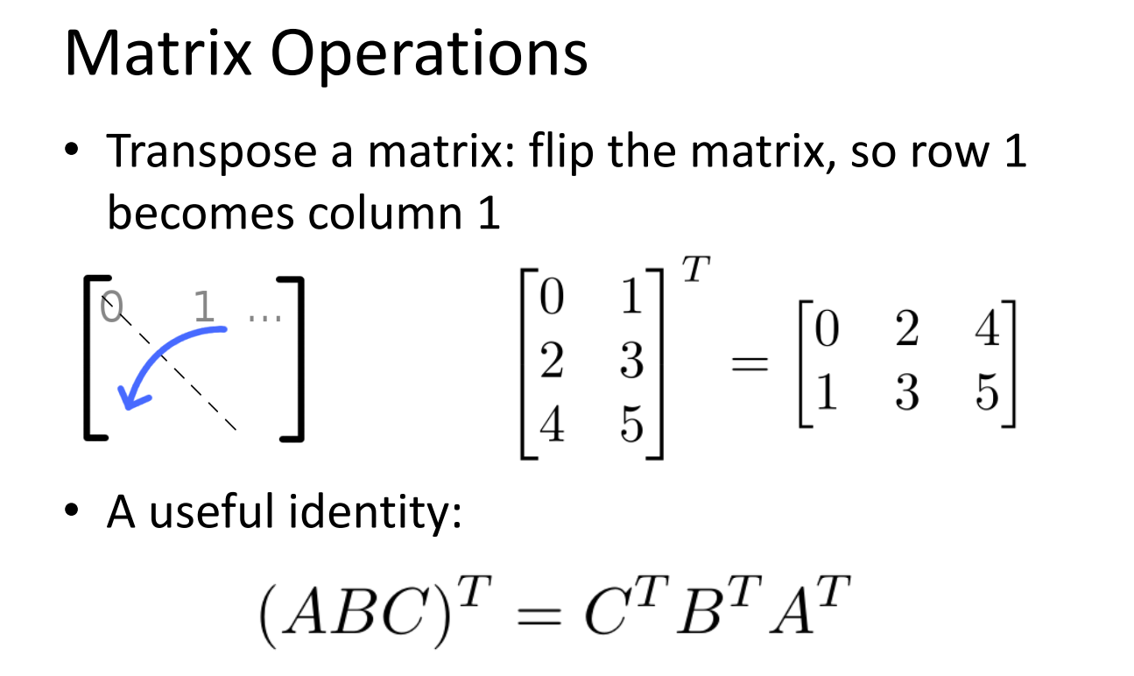
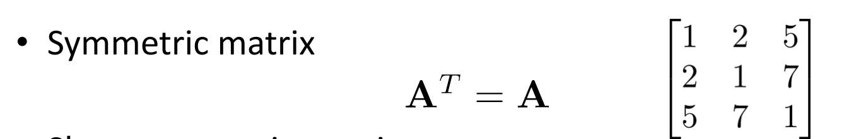

Slide 15
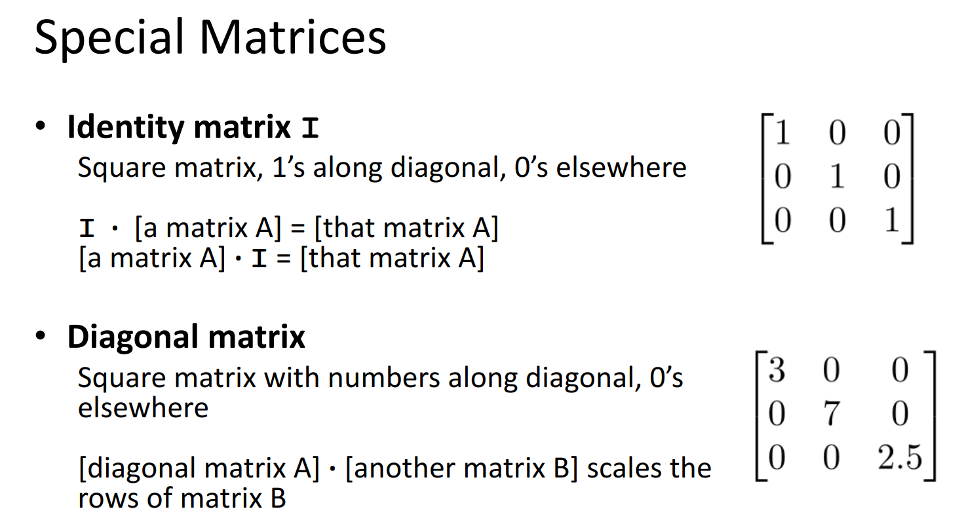

Slide 16
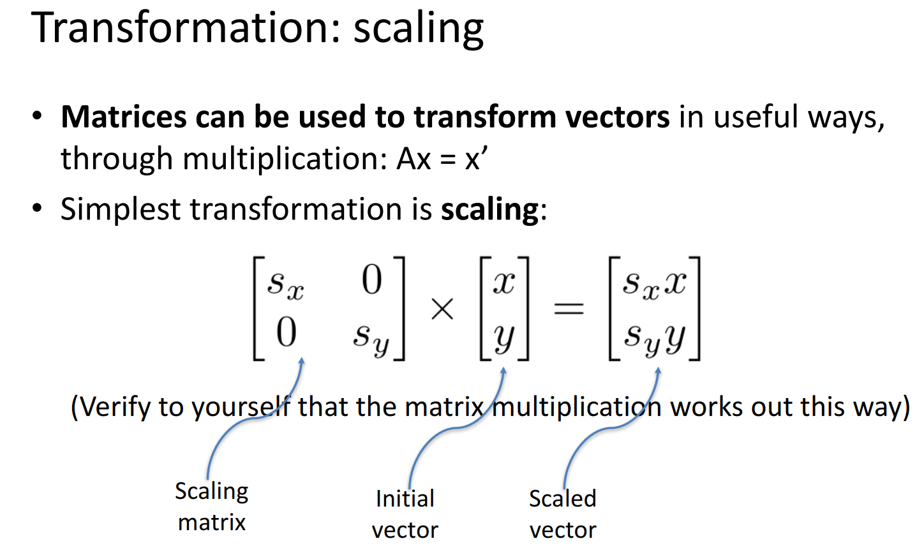

Slide 17
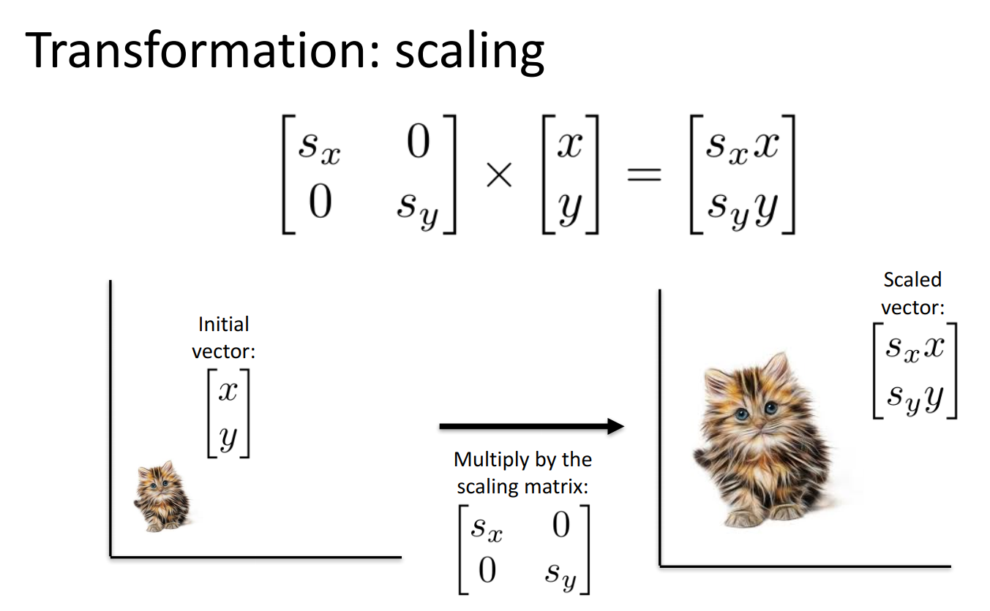

Slide 18
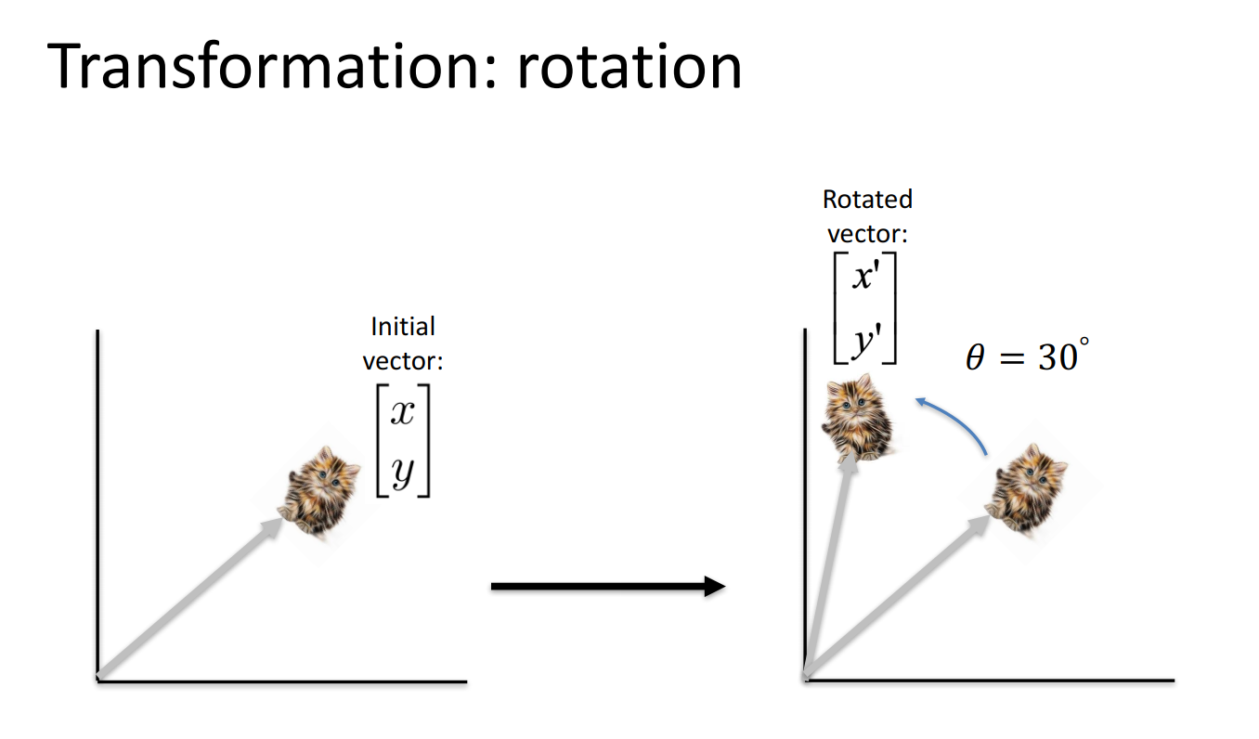

Slide 19
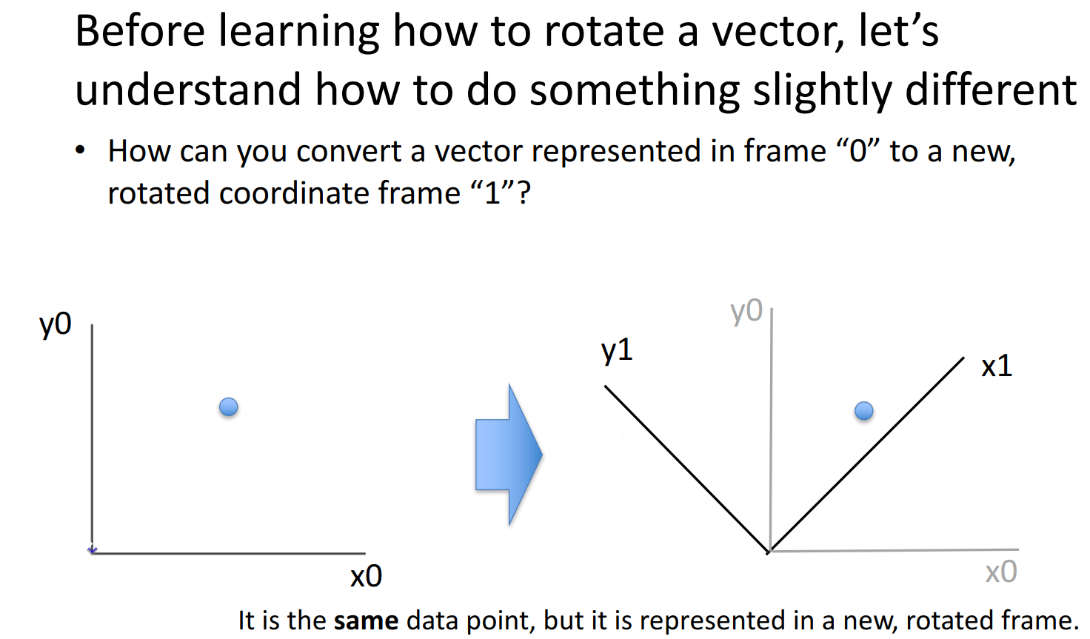

Slide 20
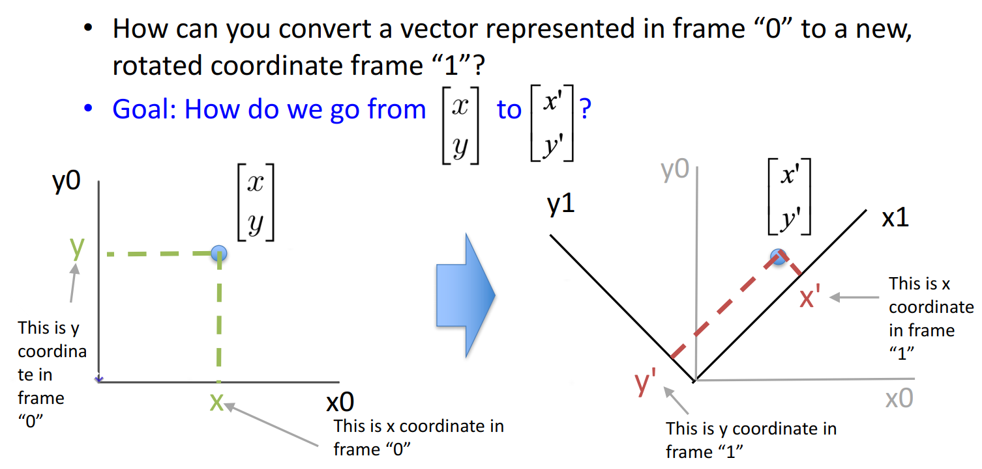
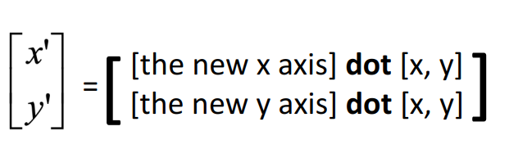

Slide 21
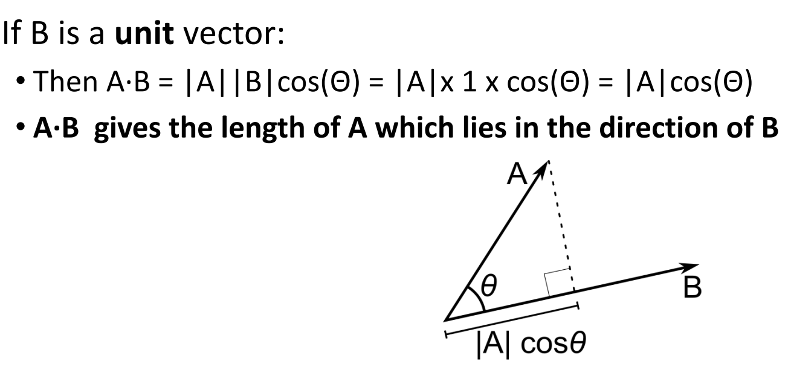

Slide 22
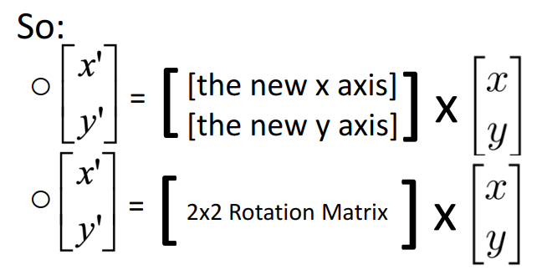
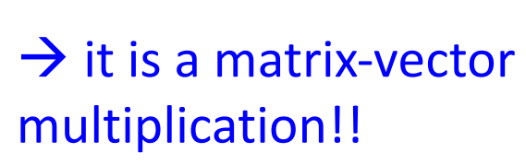

Slide 23
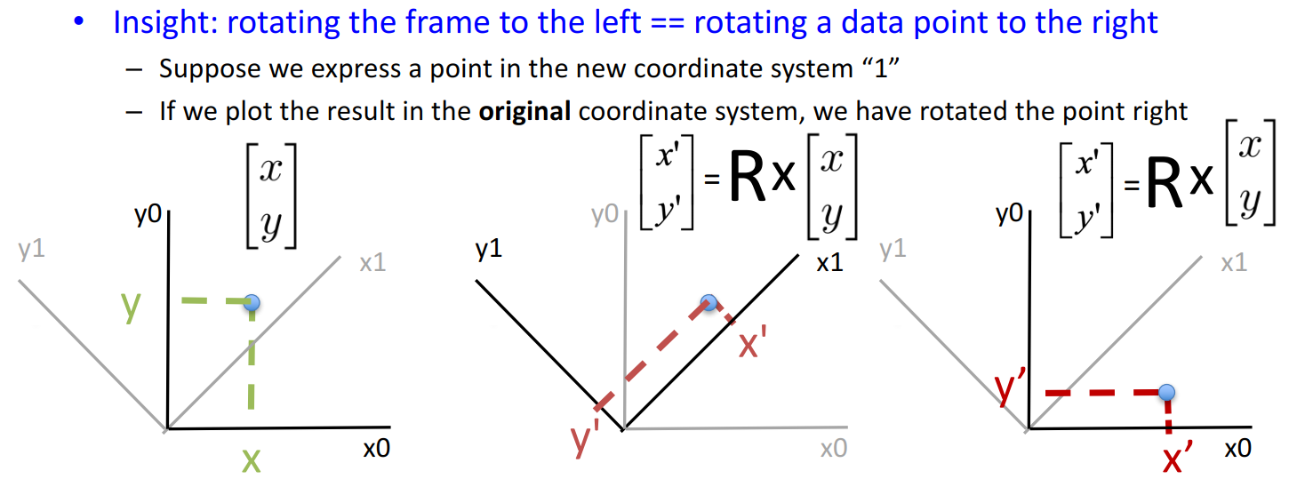

Slide 24
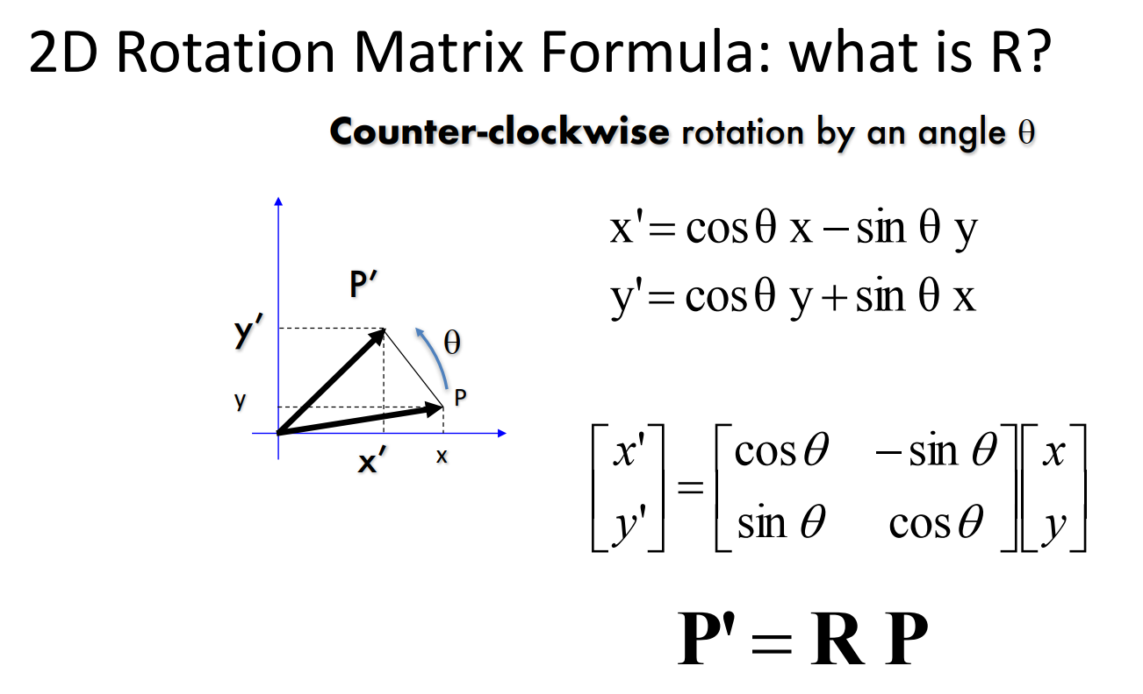

Slide 25
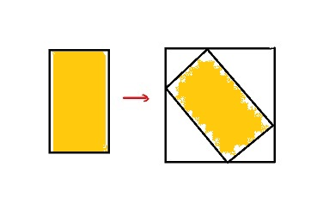
Rotation
So if we want to rotate image I= let’s say 45 degrees counter clockwise, we need:
Take each entry of image [i,j] find the new coordinates [i’,j’] in new image by using rotation matrix with ϴ=45, and after we assign at the new entry [i’,j’] value of the original image I[i,j], so we build new image I’[i’,j’]=I[i,j]
Problem:
a) we can get not full coordinate and also negative coordinate [i’,j’] , for example [-2.56, 3.1]
b) we can get the coordinate which is larger than original image
Bonus Quiz 1: Suggest an algorithm to get valid rotated image? You can check also that it works in Python

Slide 26
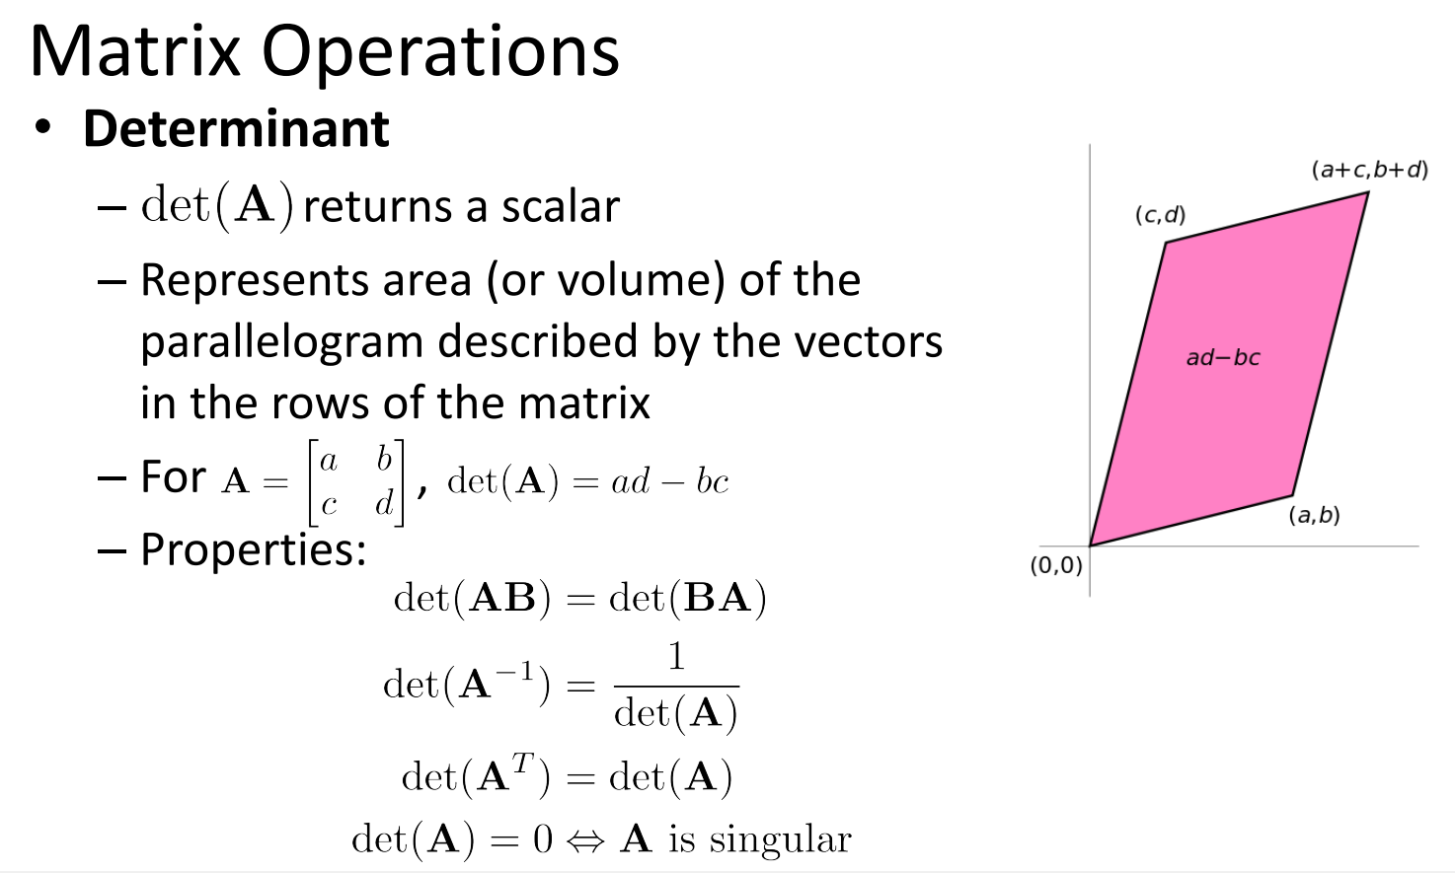

Slide 27
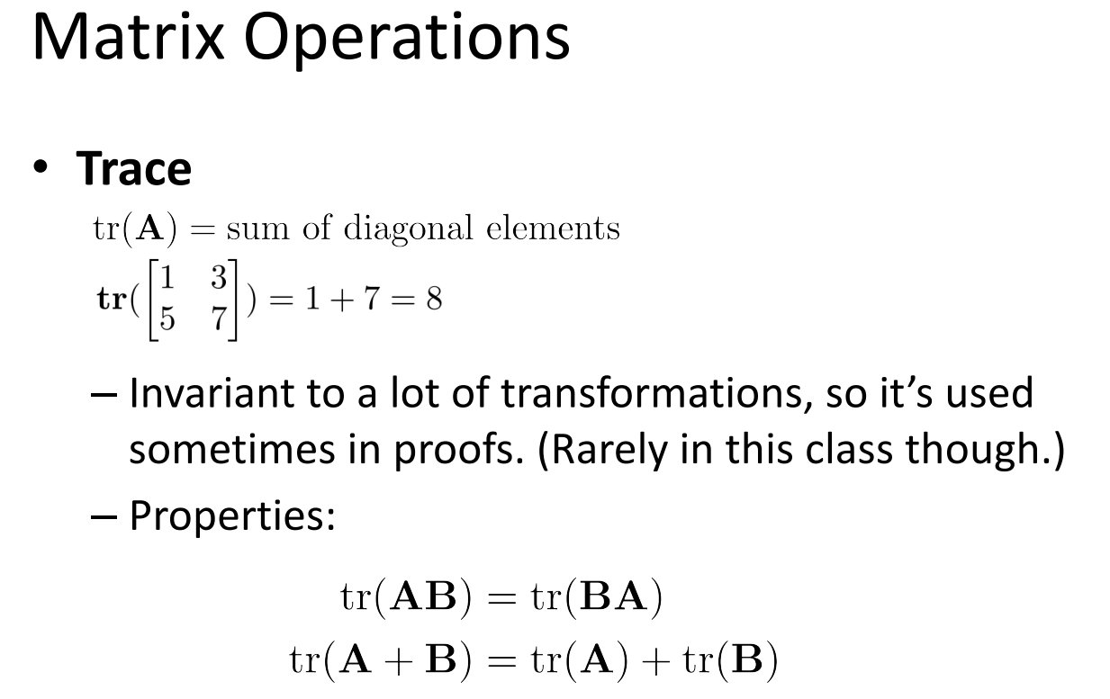

Slide 28


Slide 29




Quiz 5: What is the value of matrix
at location x=2, y=3
Math vector representation
Python representation
Quiz 6: Multiply the matrices:
Matrix quiz
Quiz 7: Indicate whether the statement: “If A is a 4x3 matrix and Bis 3x1 matrix, then the product BA is a 3x3 matrix.” is true or false
Quiz 8: Find A^{T}A if
Quiz 9: Rotate vector [1,1] by 30 degrees counter-clockwise
Quiz 10: find inverse matrix if one exists of:

Slide 30
Summary
Definition of vectors
Different distance functions: example of Euclidian distance and cosine similarity
Matrix definition
Matrix operations: sum, scale, product, transpose, inverse, rotation , determinant, trace
Special matrices: square, identity, diagonal

